Slide 1


Manual transmission of the data required by PA-15-01, and an Introduction to the OGE Extranet

Slide 2
Introduction
This session will cover the web application described APPENDIX 5 of PA-15-01.
Agencies who collect public financial disclosure reports in paper format will begin using the application by May 31, 2016.
This application is part of the new OGE Extranet suite of applications, and this session will include an introduction to the OGE Extranet.

Slide 3
Web App for reporting public financial disclosure reports in paper format
Agency Name
  the name exactly as displayed by OGE in the 2014 Agency Ethics Program Questionnaire
Reporting Year
  is the year in which the report is due. For example, a “2016” annual report is one that covers calendar year 2015 and is due in 2016
Reference Date
  date for which the data was compiled
Number of Filers
  the number of agency employees who are required to file annual public financial disclosure reports, including combination annualtermination reports
Number of Reports Filed
Number of reviews completed

Slide 4
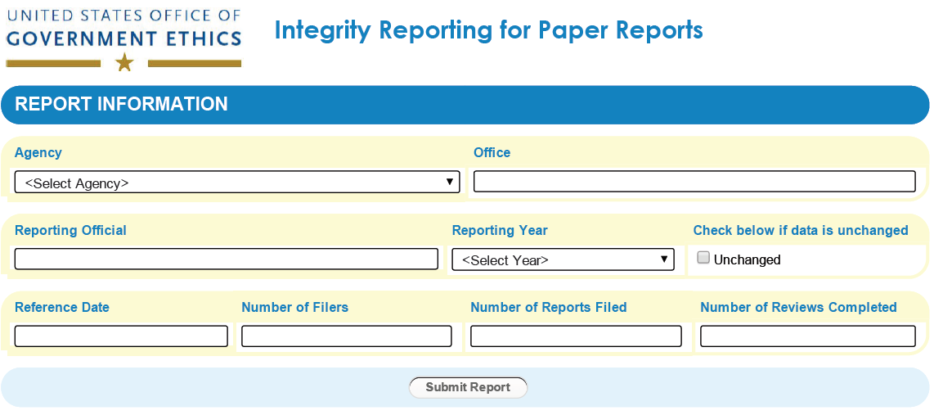
Web App for reporting public financial disclosure reports - Form
Everything should be made as simple as possible, but not simpler. Albert Einstein

Slide 5

What is the OGE Extranet?
The OGE Extranet is a web site with small apps.
You access the site with a desktop web browser or a mobile device* such as a smart phone or tablet.
Currently, links to Extranet apps will be distributed on an as needed basis.
The OGE Extranet is created by federal employees for federal employees – it is not a contractor operated site.
*Apps are functional on mobile devices, but not all apps are optimized for smaller screens

Slide 6



Extranet - a little bit of structure goes a long way
The OGE Extranet adds a level of structure to interactions with OGE which would ordinarily happen via unstructured emails or spreadsheet data calls.
Adding structure increases business process automation, and that automation reduces manual labor time and costs for both OGE and the federal ethics community.

Slide 7



Extranet – General Diagram
Extranet app replicas
on OGE LAN and OGE staff
Extranet apps on web
and ethics officials
30
minutes
App Mirror/Sync

Slide 8
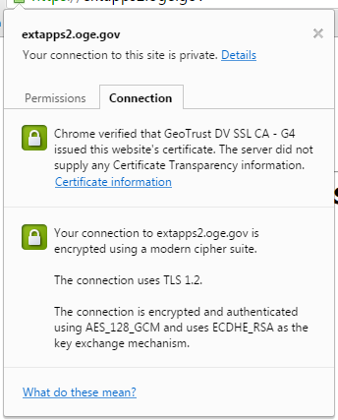

OGE Extranet - To log in or not log in
Some interactions will require a user name and password, and some will not.
All communications, with or without log in, are encrypted via a commercial SSL certificate.
Most email sent over the Internet is sent in the clear like a post card (not encrypted)

Slide 9

OGE Extranet log in
the Integrity data reporting app discussed earlier will require a user name and password.
This app automatically links logged in ethics officials to corresponding organizations, and it reduces data entry to a minimum while fully automating the compilation of the data.

Slide 10

Extranet no log in
If you registered online for one of the Summit symposium sessions you’ve already used an OGE Extranet app which did not require a password.
This app helped meter attendee slot allocations, it provided email receipts with confirmation numbers, and it automatically provided the attendee lists needed for building security staff** and for creating identification badges.
**attendee lists were manually reviewed before delivery to security staff

Slide 11

Requesting an OGE Extranet Account
You only need an account if you will use apps which require login.
Contact your OGE desk officer to request an account. Your desk officer will validate your identity and send back your account information and a temporary password.
Your login name will be your email address.

Slide 12

OGE Extranet in your mailbox
The Extranet provides limited outbound (only) email messaging. For example:
  receipts with confirmation numbers for symposium registrations;
  save/submit confirmations for annual questionnaires.
The Extranet’s outbound email messaging service could potentially provide time-based messaging functions such as gentle and friendly reminders.

Slide 13

Extranet Recap - Business Process Automation and Common Sense
The OGE Extranet is a direct, process focused, and common sense way to do many of those things federal ethics officials would ordinarily do via unstructured email. It’s not an abstract solution looking for a problem, or some confusing IT buzzword.
disruptive mindshare
organic paradigm
collaboration cloud
Epic empowerment
Thought Leader

Slide 14


